Slide 1
NASIYA NOUSHAD
214353@UST-GLOBAL.COM

Slide 2
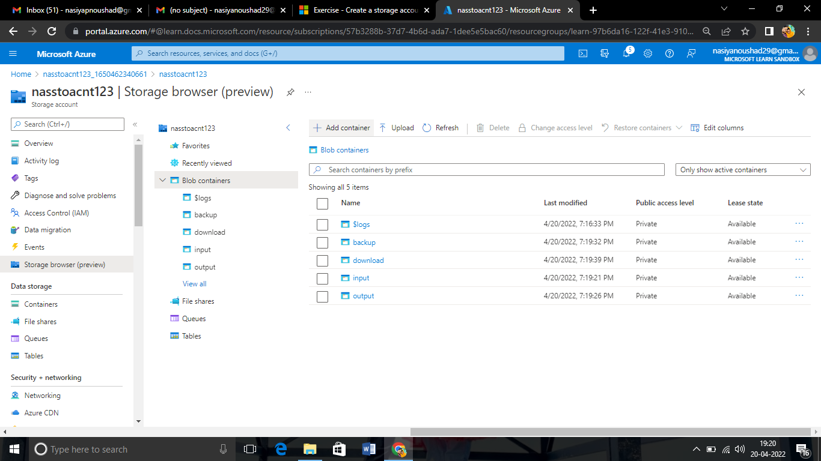
Storage Account in Azure with 4 Containers

Slide 3
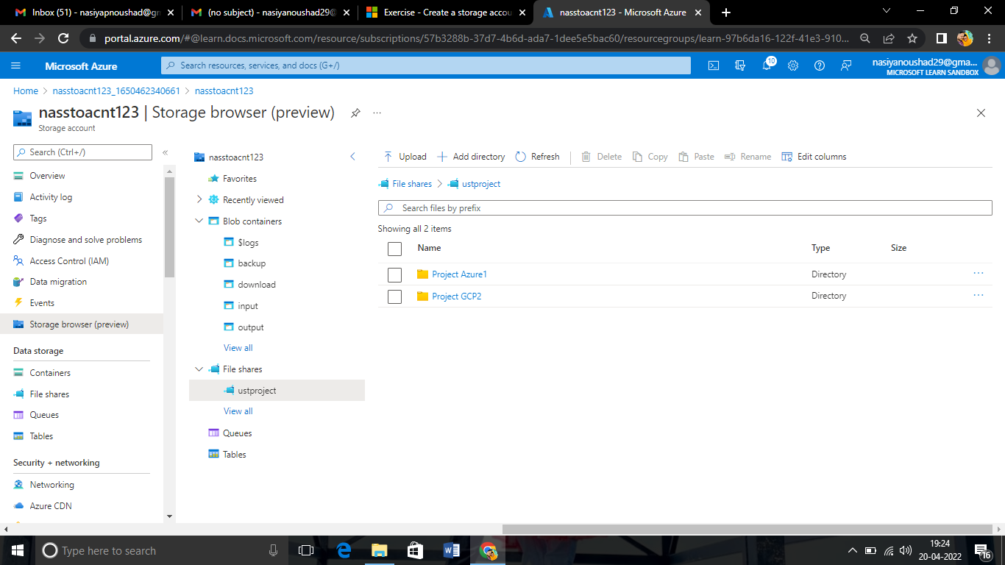
Azure File shares with 2 directories

Slide 4
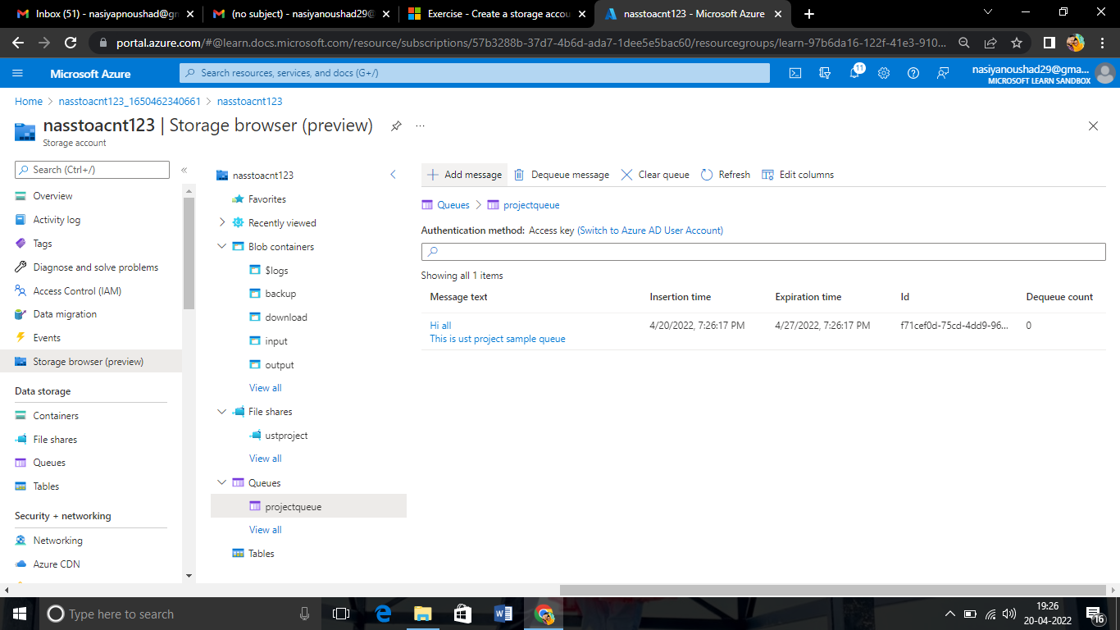
Message Queue with a message

Slide 5
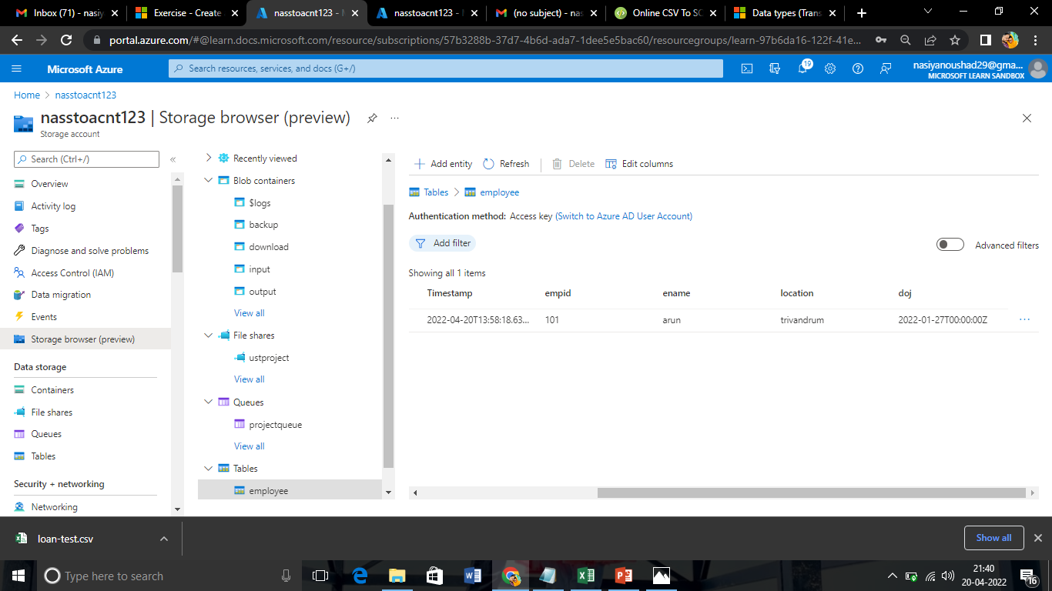
Table

Slide 6
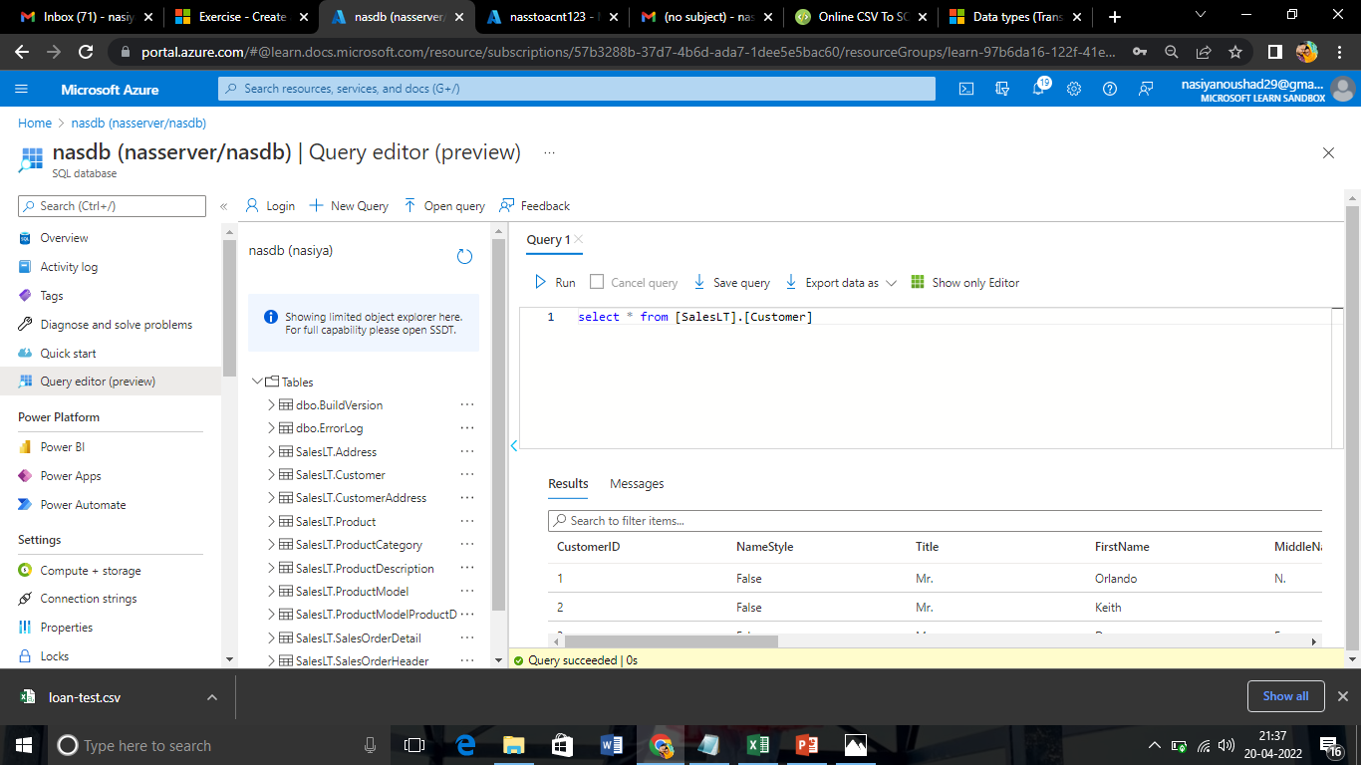
Sample Database with Query

Slide 7
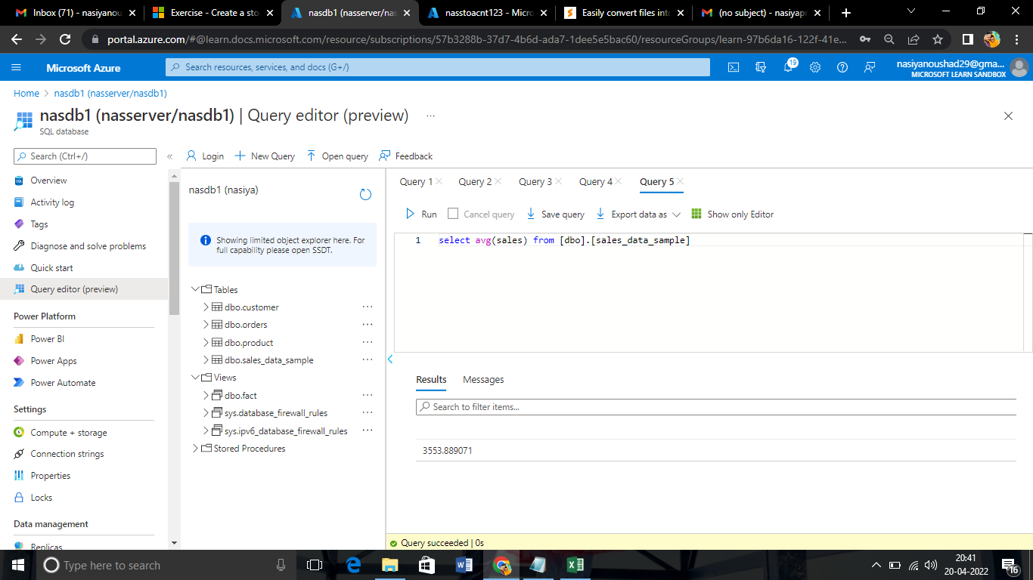
To Estimate the Unit Sales of Retail Goods

Slide 8
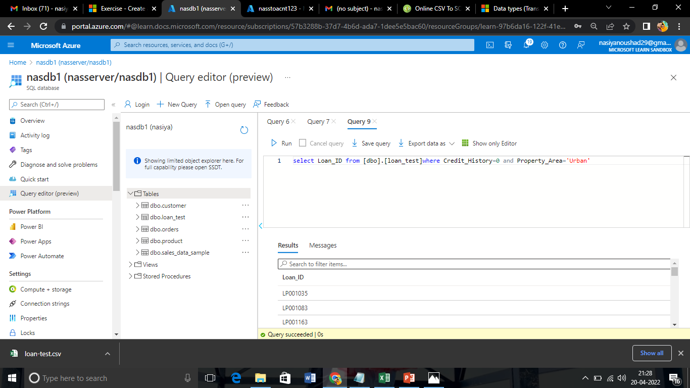
Financial Needs Programs for Consumer Loan Products

